Slide 1

System Dynamics Model for Ventilation effect on COVID-19 transmission
Christian Sørup
Daniel Sepulveda
06 May 2021
Notes:
We would like to share with describe briefly the model we have been building

Slide 2

Context
COVID-19 is transmissible through air
Transmissibility is dependent upon, among others, viral concentration in air
Ventilation has an effect on air viral concentration
Principal policy focus so far on:
Distance guidelines (density, absolute distance)
Personal air filters (masks)
Generic ventilation guidelines
Opportunity for
Scenario testing for different indoor environments
Activity-dependent ventilation (e.g., Restaurants, Classrooms)
Identification of Operational recommendations
Ventilation System Characteristics (Q, pf, RH)
Activity type and duration (e.g., number and length of school breaks)

Slide 3
Proposal outline
Develop a:
Simulation model of relationship between Transmission rate and:
Ventilation, activity type, level of activity
Identify policy levers and their sensitivity
Apply to specific example cases
In order to:
Provide a learning platform with the explicit representation and simulation of:
Accumulations (Sources of Inertia)
Causal relationships
Feedback Loops
Exogenous versus Endogenous variables
Through the use of:
System Dynamics Method

Slide 4
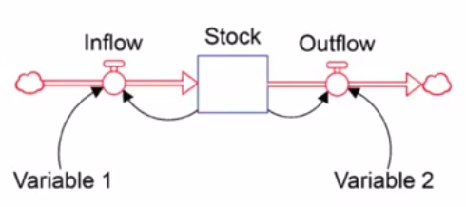
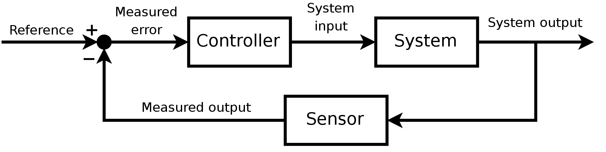
System Dynamics versus traditional control
Stock and Flow representation
States as Accumulations
Focus on Relationships
Important variables not necessarily quantified
Frequency domain analysis
Focus on Transfer Function
Focus on stability of Frequency Response (Bode, Nyquist)
Control Theory
System Dynamics
States
Dynamic modelling (over time)
Polarity (Pos.&Neg.)
Feedback (Pos. & Neg.)

Slide 5
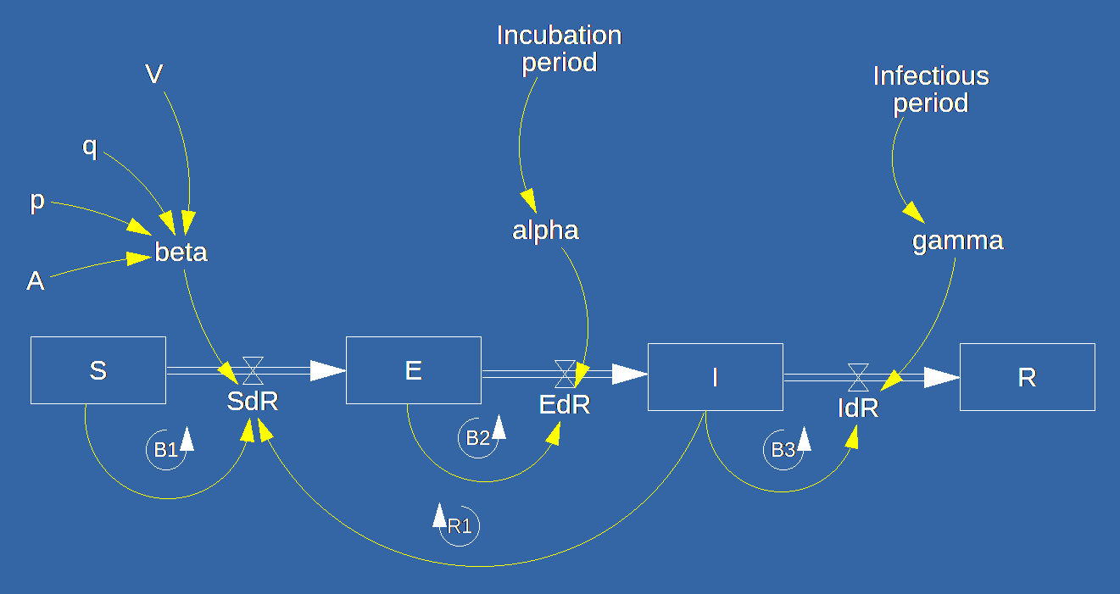
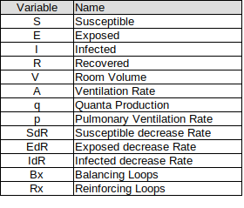
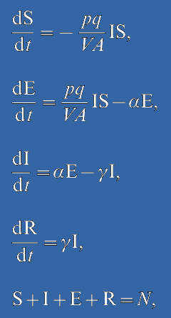
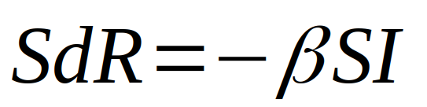
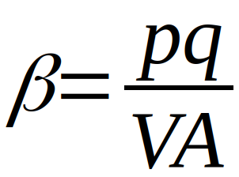
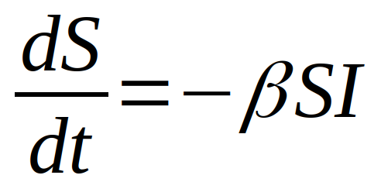
COVID-19 Model Equations
Model Source: Noakes, C.J., Beggs, C.B., Sleigh, P.A. and Kerr, K.G., 2006. Modelling the transmission of airborne infections in enclosed spaces. Epidemiology & Infection, 134(5), pp.1082-1091.

Slide 6
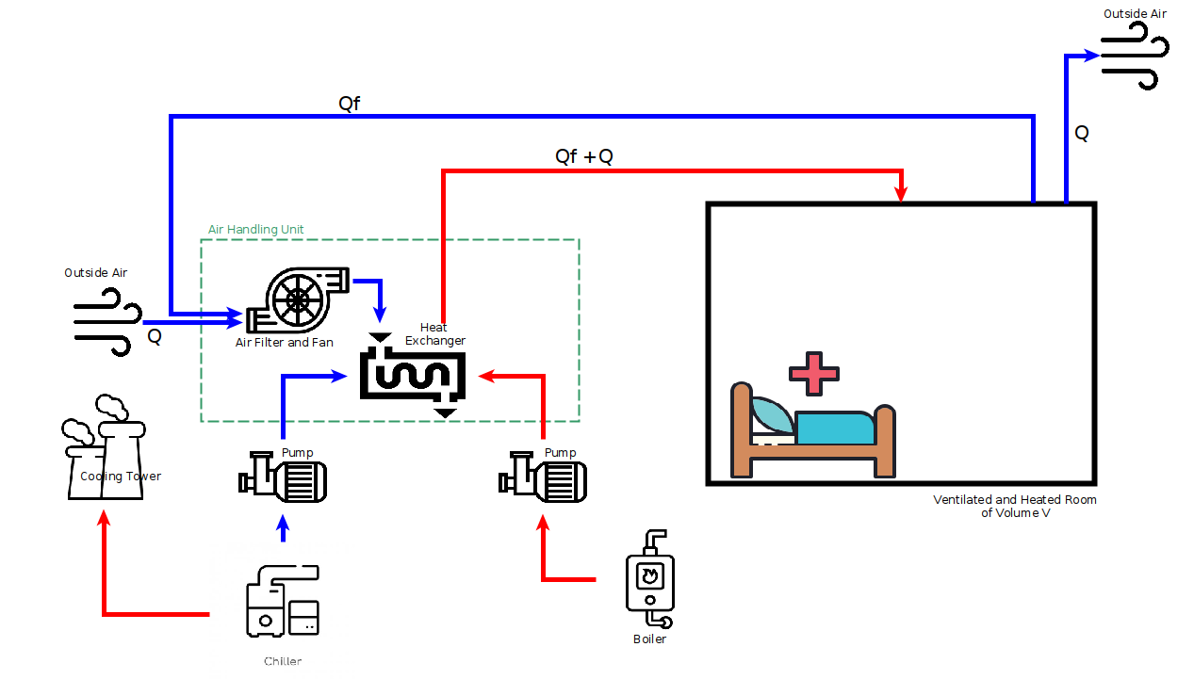


Ventilation : Simple Ventilation System
C(t)

Slide 7
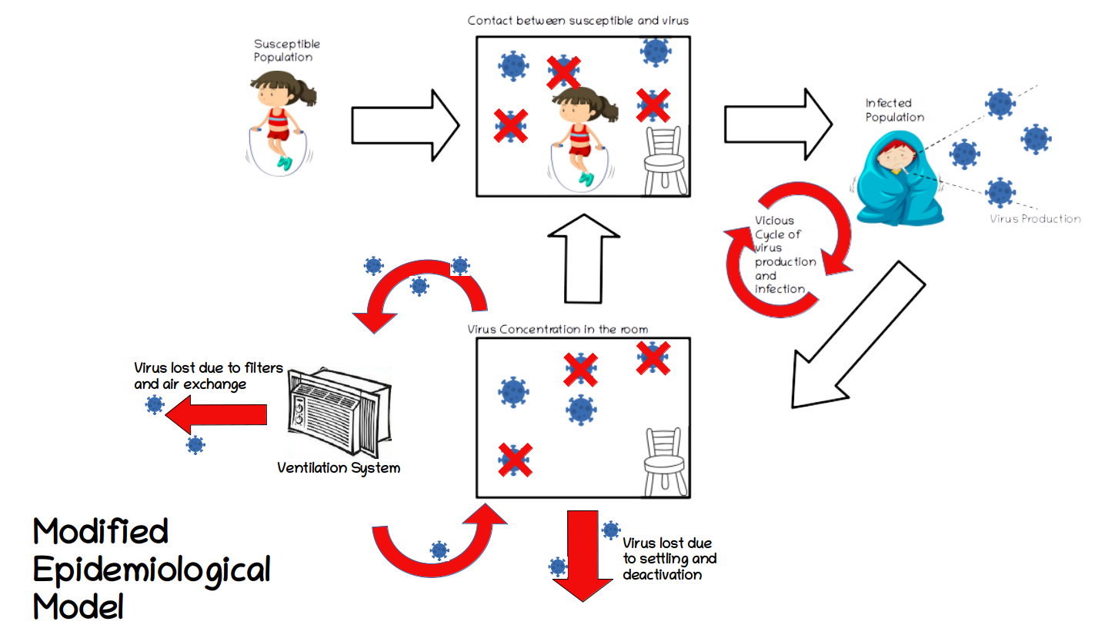

Slide 8
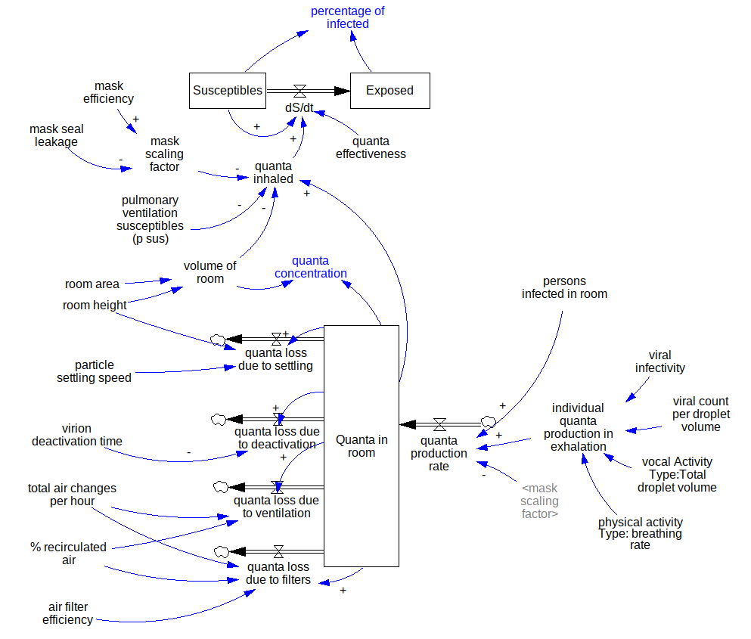
System
Dynamics
Model
Explicit Representation of
Accumulations (Inertia)
Causal Relationships
Exogenous vs Endogenous Variables
Feedback Loop visibility (R,B)

Slide 9
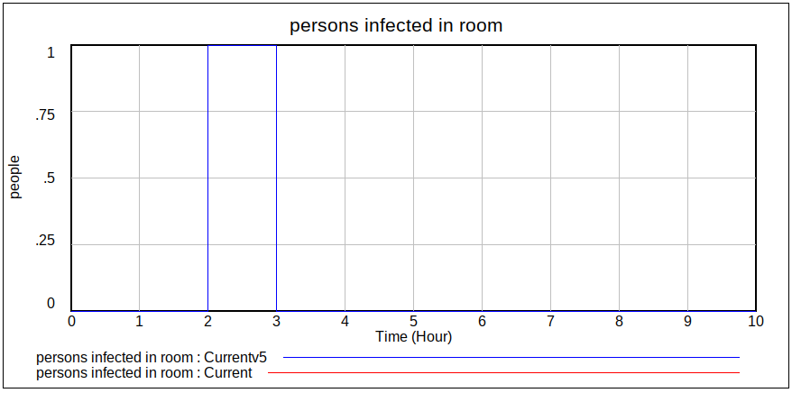
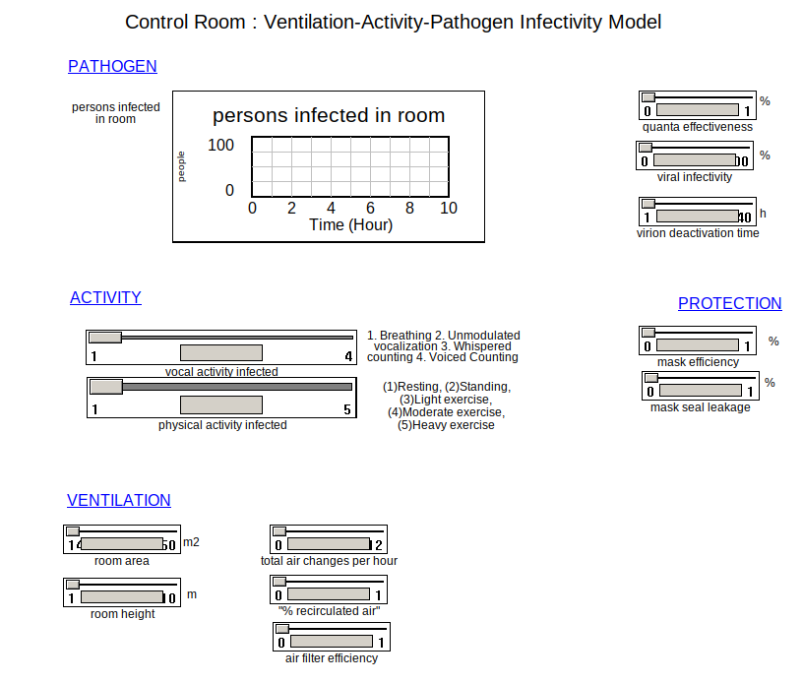
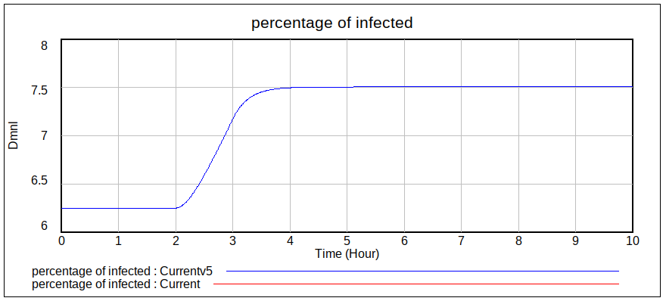
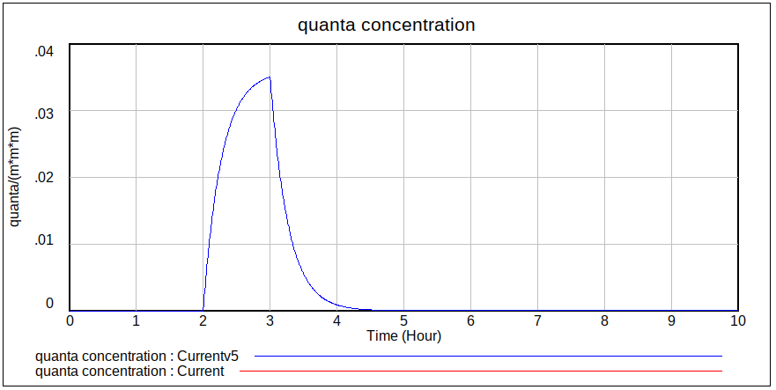
Model Results

Slide 10
Application Example:
Let’s go to VENSIM
Notes:
We would like to share with describe briefly the model we have been building

Slide 11
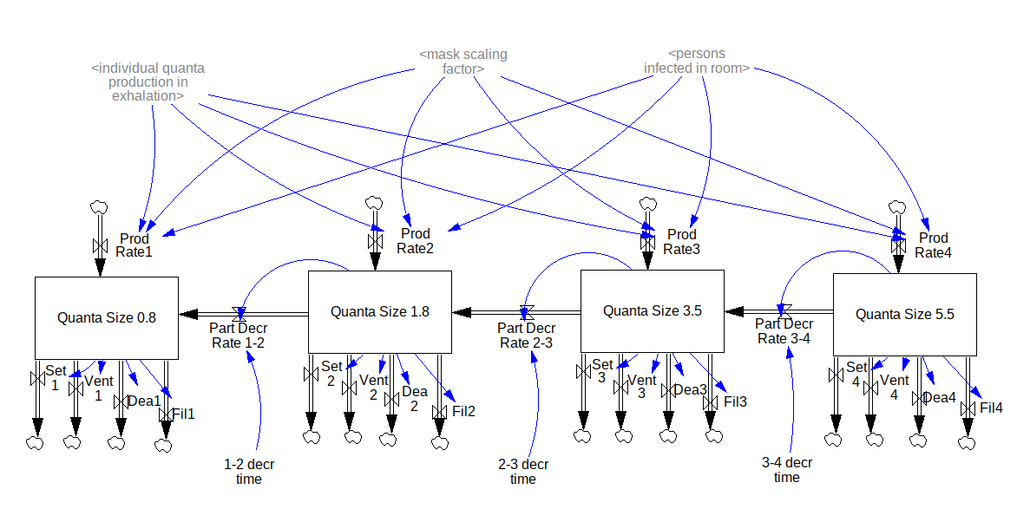
Next Steps
Calibrate Model
Data for pathogen-infections-ventilation
Consider particle size

Slide 12
Thank you
Notes:
We would like to share with describe briefly the model we have been building

